Slide 1
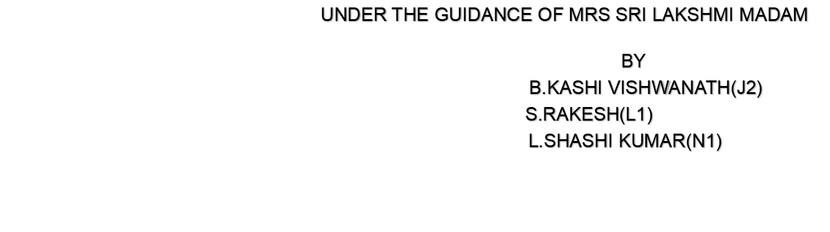

Slide 2
CONTENTS
Abstract
Idea
Tools Used
Design
Algorithm
Pseudo Code
Outputs

Slide 3
ABSTRACT
Handwriting has a great significance to it, in fact, our entire Indian constitution is handwritten, that is the importance of it. So our project is entirely based on converting the normal text to handwriting. We generate images comprised of the information in handwriting. And ask the user to give his handwriting by writing down alphabet sets( capitals and small letters ) on a piece of paper and then take a picture of it and give it as the input, then the algorithm figures out what is what and then generates an array of pixels for every input text string. Thus the combination of sentences forms an entire page.

Slide 4
IMAGE PROCESSING IN JAVA
JAVA has wide variety of classes to deal with Images in particular.
We are using BufferedImage Class widely across our entire project due to its abundance methods and features.
BufferedImage Class has a unique feature which is very helpful for us to deal with pixels of image and load them into respective data structure and then do required manipulations to the picture at the pixel level and the name of the method is getRGB() which returns an integer value which holds the combination of rgb values into a single unit.

Slide 5
IDEA-THOUGHT PROCESS
So, our idea has taken its birth from writing numerous vague assignments in the very beginning of our education, and we are not against the assignments but being a student just showing off that pain.
In the very first year I wanted to make an app which can convert text to our own handwriting, eventually I forgot about it, nad in 3rd year when we were asked to think about group project we recollected this good old idea and started working on it.

Slide 6
TOOLS USED
Java (jdk 11)
Intellij Idea (student license)[IDE]
Git-Hub
Android Studio
Rational Rose (For UML Diagrams)

Slide 7
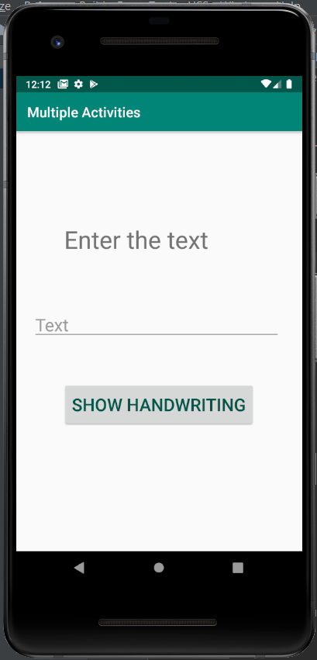



ARCHITECTURE
Local Area Network
client
Server

Slide 8
ALGORITHM
Input : Handwriting images(Capital Letters, Small Letters , Numbers), Input text string
Step 1 : Cleaning the images by making them black and white and storing only required pixels.
Step 2 : Splitting the resultant image with space to obtain indi- -vidual alphabets and storing them in a hashmap.
Step 3 : Iterating on input string and concatenating the corresponding alphabet images into final result.

Slide 9
SOURCE CODE (step - 1)
int[][] returnRequiredPixels(int[][] input){
int[][] pixelBW = generateBlackAndWhite(input);
int[][] pixelRequired = new int[input.length][input[0].length];
for(int i=0;i<pixelRequired.length;i++){
for(int j=0;j<pixelRequired[0].length;j++){
if(pixelBW[i][j] != -1){
pixelRequired[i][j] = input[i][j];
}
else {
pixelRequired[i][j] = -1;
}
}
}
return pixelRequired;
}

Slide 10
step - 2
private void splitTheDataIntoHashMap(int[][] input,int index){
// This function basically takes the entire alphabet set as an 2D Array and then figures out alphabets from it
// and stores the corresponding 2D Array in a data structure ( hash map ) for further use
int[][] temp = new int[input.length][300];
int[][] rotated = rotateClockWise(input);
int indexForKey = index;
int countForTemp = 0;
for (int[] value : rotated) {
int count = 0;
for (int j = 0; j < rotated[0].length; j++) {
if (value[j] == -1) {
count++;
}
}
if (count != value.length) {
System.arraycopy(value, 0, temp[countForTemp++], 0, value.length);
}
if (count == value.length) {
if (isArrayEmpty(temp)) {
continue;
}
int[][] test = new int[countTillNumber(temp)][temp[0].length];
for (int a = 0; a < test.length; a++) {
System.arraycopy(temp[a], 0, test[a], 0, test[a].length);
}
int[][] intermediate = rotatePictureAntiClockWise(test);
int northToSouth;
for(northToSouth=0;northToSouth<intermediate.length;northToSouth++){
if(intermediate[northToSouth][0] == -1){
break;
}
}
int[][] inter = new int[intermediate.length - northToSouth][intermediate[0].length];
for (int[] ints : inter) {
System.arraycopy(intermediate[northToSouth++], 0,
ints, 0, intermediate[0].length);
}
this.data.put(indexForKey++, changeColor(inter));
countForTemp = 0;
verifyTheImage(indexForKey, changeColor(inter));
temp = new int[input.length][300];
}
}
generateSpacePicture(indexForKey);
}

Slide 11
step - 3
private int[][] generateHandWriting(){
int[][] out = new int[1080][1920];
createWhitePaper(out);
int row = 0;
for (String s : textFromFile) {
int indexForI = 10;
for (int i = 0; i < s.length(); i++) {
copyCharacterIntoArray(data.get(alphabet.get(s.charAt(i))), indexForI, out,row);
indexForI += data.get(alphabet.get(s.charAt(i)))[i].length + 5;
}
row += data.get(alphabet.get(s.charAt(s.length() -1))).length;
}
return Input.rotatePictureAntiClockWise(out);
}

Slide 12
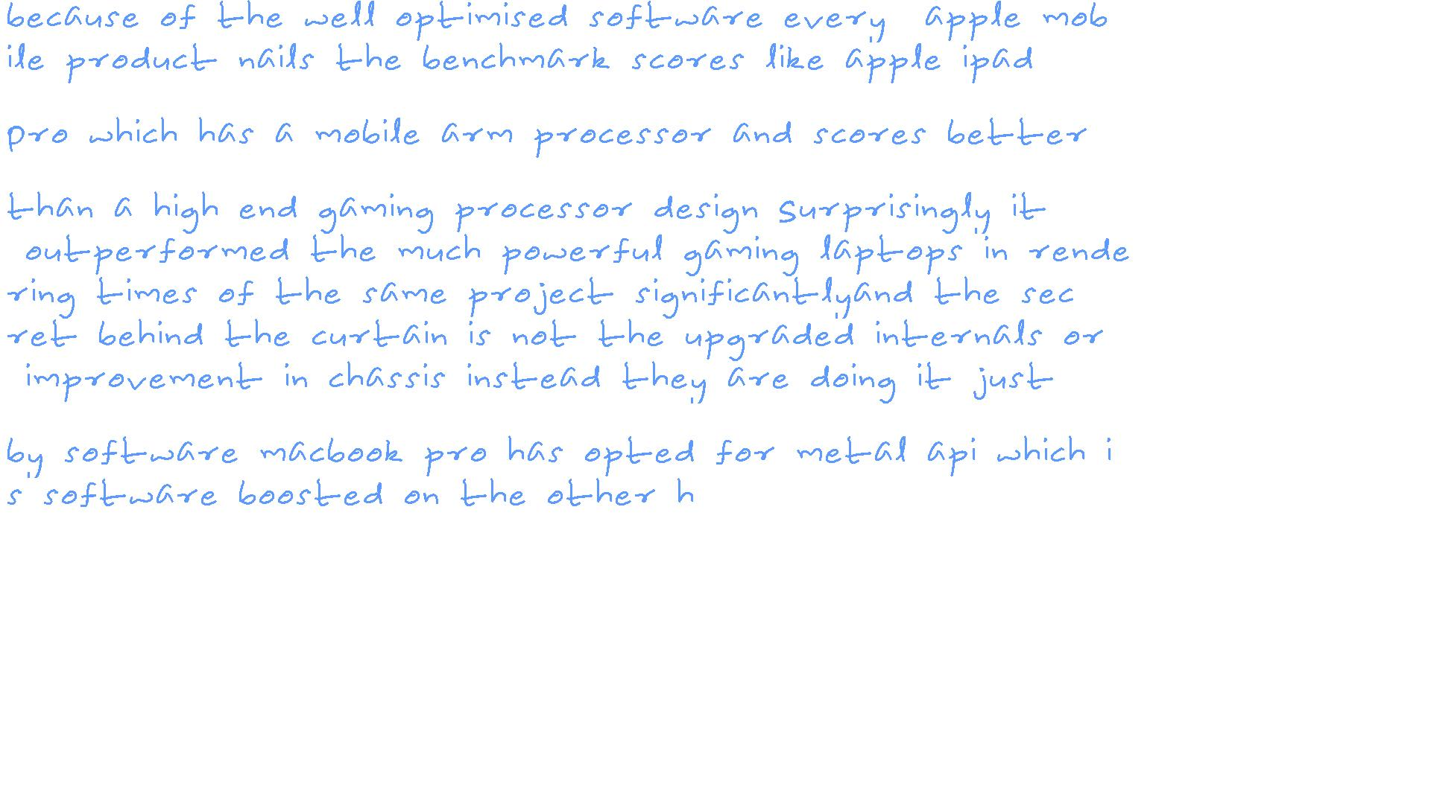
OUTPUTS

